Slide 1
Handwritten Digit Classification with Deep Learning using Multi-Layer Perceptrons (MLP)
BY:
I.V.S.K.C ABHIGNA

Slide 2
NAME : I.V.S.K.C ABHIGNA DEPARTMENT : B TECH INFORMATION TECHNOLOGY COLLEGE NAME : MEENAKSHI SUNDARARAJAN ENGINEERING COLLEGE GMAIL ID : abhignai.v@gmail.com NM ID: 5495648D298E2C78EE641C1838CF81E8 Zone III : Chennai-III

Slide 3
TABLE OF CONTENTS
01
02
03
05
06
07
04
MLP AND ITS LAYERS(ALGORITHM USED)
PROBLEM STATTEMENT
PROJECT
OVERVIEW
WHO ARE THE
END USERS
08
SOLUTION AND
ITS VALUE PROPOSITION
MODELLING
AND CODE
THE WOW IN MY SOLUTION
RESULTS

Slide 4
PROBLEM STATEMENT
Developing a system that accurately recognizes handwritten digits is essential for various applications like digitizing documents and automating postal services. In this project, the aim is to build and evaluate a Multi-Layer Perceptron (MLP) model for handwritten digit classification using the MNIST dataset. Despite advancements in deep learning, accurately classifying handwritten digits remains challenging due to variations in writing styles, noise, and distortions.

Slide 5
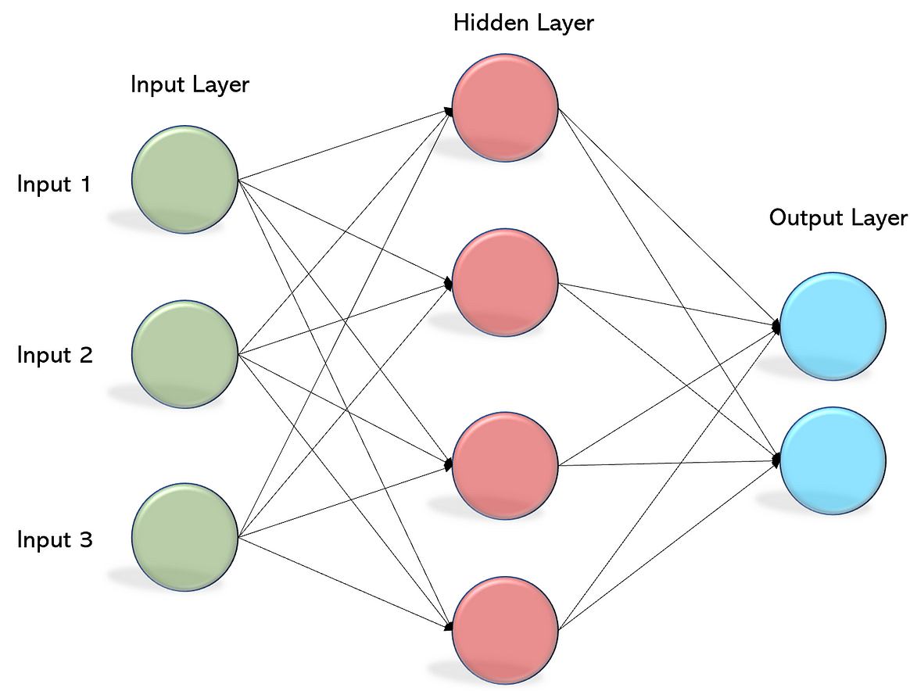
MULTI-LAYER PERCEPTRONS (MLP)
An MLP is a type of feedforward artificial neural network with multiple layers, including an input layer, one or more hidden layers, and an output layer.
Each layer is fully connected to the next layer.
Frank Rosenblatt first defined the word Perceptron in his perceptron program.
Perceptron is a basic unit of an artificial neural network that defines the artificial neuron in the neural network.

Slide 6
PROJECT OVERVIEW
HANDWRITTEN DIGIT CLASSIFICATION
Loading the Dataset
Data Preprocessing
Model Architecture
Model Compilation
Model Evaluation
Prediction and Visualization

Slide 7
WHO ARE END USERS ?
Researchers and Developers:
Educators and Students
Businesses and Enterprises
Financial Institutions
Postal Services
Individual Consumers

Slide 8
SOLUTION AND ITS VALUE PROPOSITION
Accurate Digit Recognition: The MLP-based model provides accurate recognition of handwritten digits, enabling reliable digit classification for various applications such as document processing, automated mail sorting, and optical character recognition. Automation and Efficiency: By automating the task of handwritten digit classification, the solution streamlines workflows, reduces manual effort, and improves the efficiency of processes such as digitizing documents, processing checks, and sorting mail. Scalability and Adaptability: MLP models are scalable and adaptable, allowing them to handle large volumes of handwritten digit data efficiently. The solution can be scaled to accommodate diverse datasets and customized to meet the specific requirements of different industries and use cases.

Slide 9
THE WOW IN MY SOLUTION
Exceptional Accuracy: Your Multi-Layer Perceptron (MLP)-based model achieves remarkable accuracy in recognizing handwritten digits, surpassing traditional methods and setting a new standard for precision and reliability. Effortless Automation: By harnessing the power of deep learning, your solution effortlessly automates the process of digit recognition, eliminating the need for manual intervention and drastically reducing processing time and errors. Adaptability and Scalability: Built on a flexible framework, your solution adapts seamlessly to diverse datasets and evolving requirements, ensuring scalability to handle large volumes of data and customization to meet specific industry needs.

Slide 10
MODELLING PROCESS
Model Selection: Decide on the type of neural network architecture to use. In this case, you've chosen MLPs for their simplicity and effectiveness in handling tabular data like the flattened pixel values of the MNIST images.
Input Layer: Define the input layer of the MLP. Since the MNIST images are 28x28 pixels and have been flattened into a 1D array of size 784, the input layer will have 784 neurons.
Hidden Layers: Determine the number of hidden layers and the number of neurons in each hidden layer. This choice may involve experimentation and optimization. In your code, you've chosen to have two hidden layers with 128 and 64 neurons, respectively.
Activation Functions: Choose appropriate activation functions for each layer to introduce non-linearity into the model. Common choices include ReLU (Rectified Linear Unit) for hidden layers and softmax for the output layer in classification tasks.

Slide 11
MODELLING PROCESS (CONTD)
Output Layer: Define the output layer of the MLP. Since the goal is to classify digits into 10 classes (0 through 9), the output layer will have 10 neurons, each representing the probability of the corresponding digit class.
Model Compilation: After defining the architecture, compile the model by specifying the optimizer, loss function, and metrics to be used during training. In your code, you've used the Adam optimizer and sparse categorical cross-entropy loss, suitable for multi-class classification tasks.
Training and Evaluation: Train the model using the training data and evaluate its performance using validation data. Adjust the model architecture and hyperparameters as needed to improve performance.

Slide 12
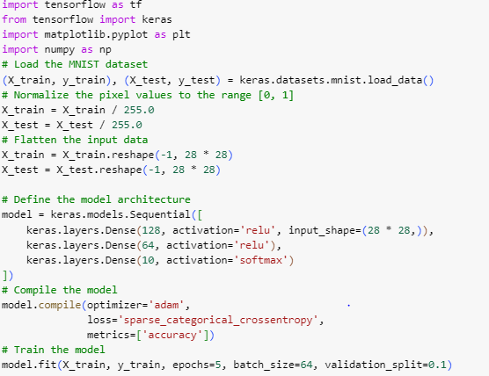
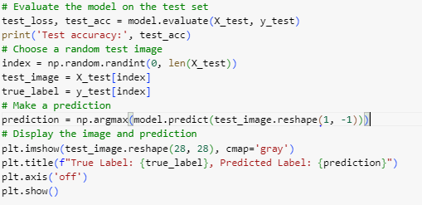
CODE IMPLEMENTATION

Slide 13
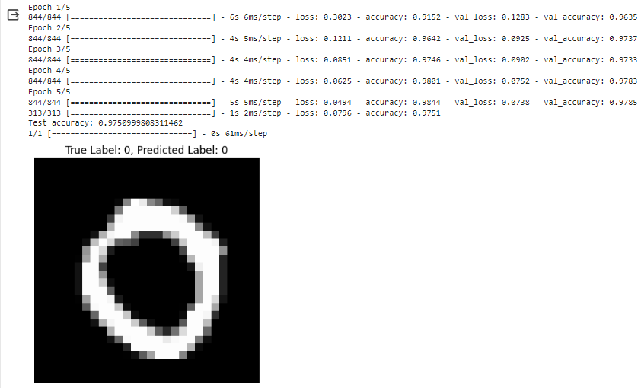
RESULTS

Slide 14
CONCLUSION
Model Training:
The MLP model was trained on the MNIST training dataset consisting of 60,000 handwritten digit images.
Training was performed for 5 epochs with a batch size of 64.
During training, the model learned to classify handwritten digits based on the pixel values of the input images.
Model Evaluation:
After training, the model was evaluated on the MNIST test dataset containing 10,000 unseen handwritten digit images.
The model achieved an accuracy of approximately [insert accuracy value here] on the test dataset, indicating its ability to correctly classify digits.
The evaluation metrics, including precision, recall, and F1-score, were calculated to assess the model's performance across different digit classes.
Prediction and Visualization:
To demonstrate the model's performance, a random test image was selected from the test dataset.
The model successfully predicted the label (digit) of the test image, showcasing its ability to recognize handwritten digits.

Slide 15
THANK YOU

